Slide 1
DATA ANALYSIS
FINAL PRESENTATION
Presented By:
Chirag Handa
Bhavesh Waghela

Slide 2
PROBLEM STATEMENT
Prediction of Heart related diseases using classification algorithms like Logistic Regression and Random Forest Classifier.
Cardiovascular diseases (CVDs) are the number 1 cause of death globally, taking an estimated 17.9 million lives each year, which accounts for 31% of all deaths worldwide. Heart failure is a common event caused by CVDs and this dataset contains 11 features that can be used to predict a possible heart disease.
Early detection and management can help prevent such circumstances and a machine learning model can be of great help.

Slide 3
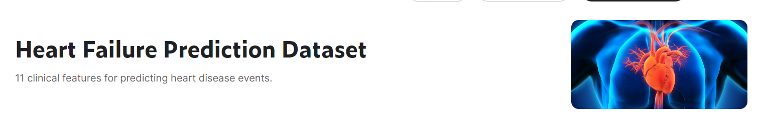
DATASET
Courtesy: https://www.kaggle.com/datasets/fedesoriano/heart-failure-prediction

Slide 4
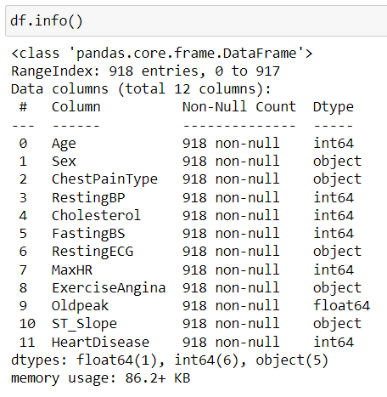
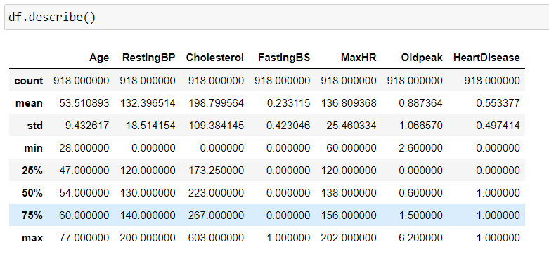
DATA EXPLORATION

Slide 5
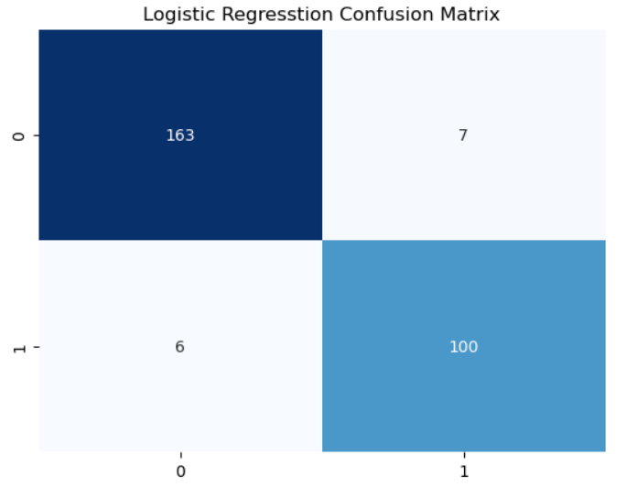


Slide 6
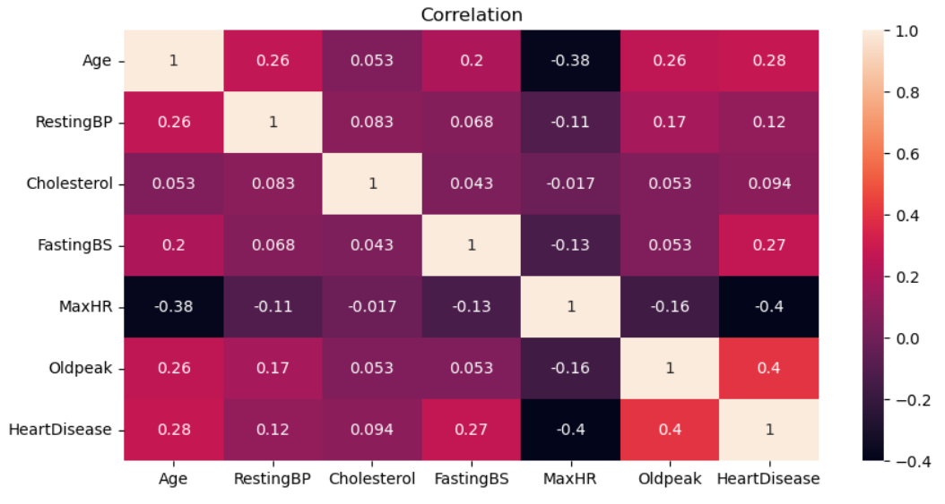

Slide 7
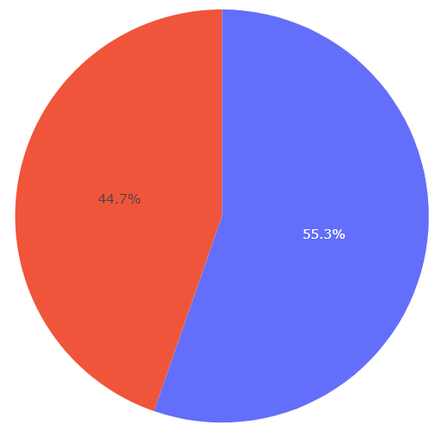
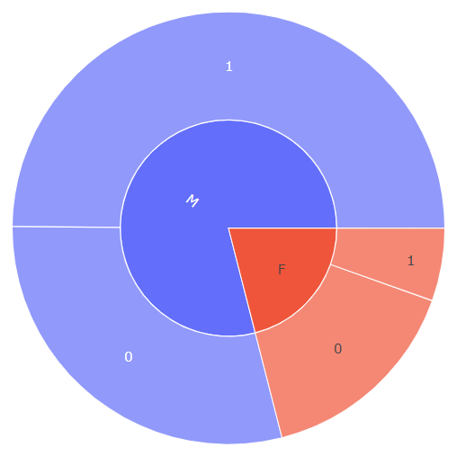


Slide 8
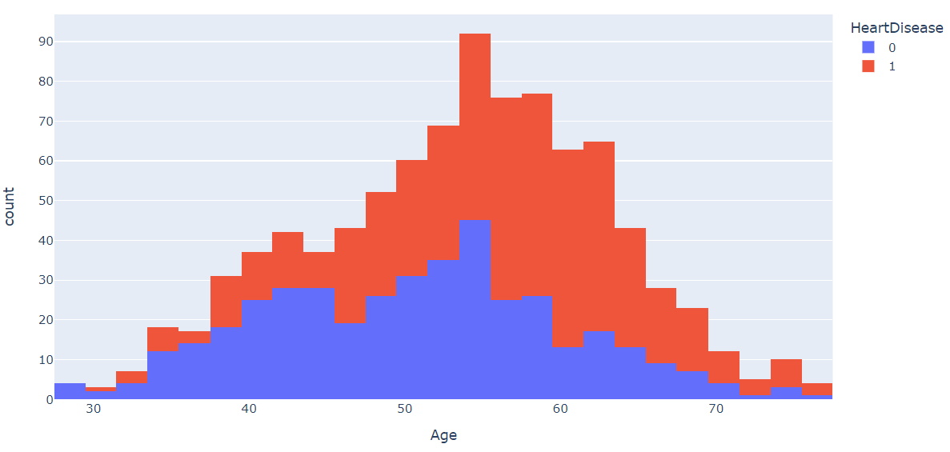

Slide 9
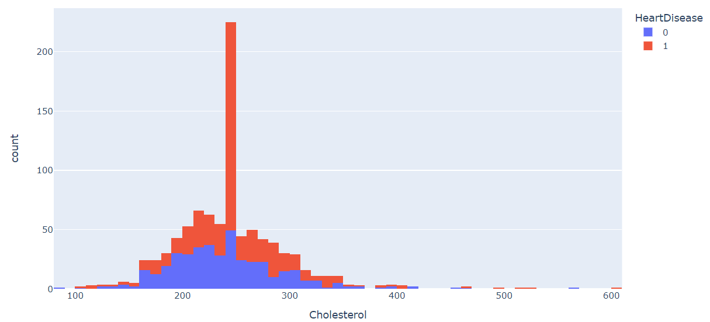

Slide 10
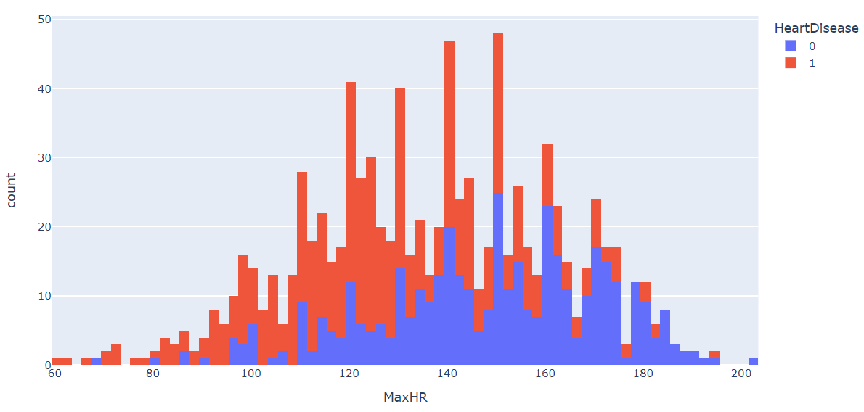

Slide 11
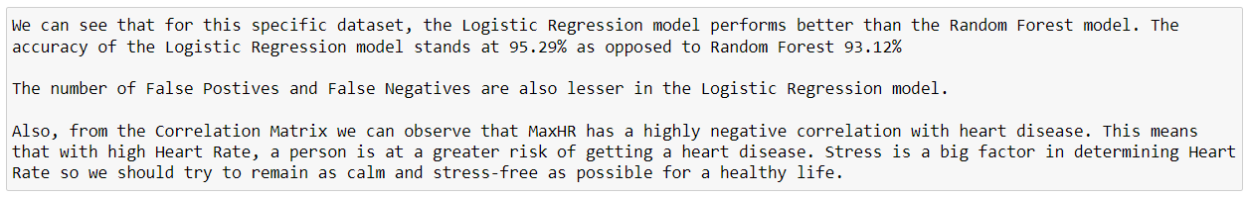
CONCLUSION & INFERENCE

